Slide 1
Just Who or What is a CGFM?
Jerry E. Durham, CGFM, CPA, CFE
Jerry.Durham@cot.tn.gov

Slide 2
Just Who or What is a CGFM?
Thank you for asking!
CGFM = Certified Government Financial Manager

Slide 3
Just Who or What is a CGFM?
Do you know the significance of the numbers:
3
7
1
2

Slide 4
Just Who or What is a CGFM?
Nashville Chapter 2013 CGFMs:
LaKenya Wrightsil, CGFM, TennCare
Laura Isbell, CGFM, Comptroller
Kay Ulmer, CGFM, Corrections
Nena Graham, CGFM, Williamson County
Drew Sadler, CGFM, Comptroller
Lisa Wells, CGFM, TennCare
Anyone else?

Slide 5
Just Who or What is a CGFM?
Meet One of our most recent CGFMs:
Drew Sadler

Slide 6
Just Who or What is a CGFM?
The Facts:
Inception in 1994 making it one of the oldest and most recognizable designations for government.
More than 15,000 individuals have received the designation so far.
I’m looking for 15,001.

Slide 7
Just Who or What is a CGFM?
Diane Dudley (Partner, KPMG, LLP)
"When we are hiring and we notice the CGFM next to a candidate’s name, we are more likely to offer them an interview. We have not made the CGFM a requirement for hiring or promotion, but if you have the CGFM, it demonstrates to us the type of initiative that will make you successful in this practice."

Slide 8
Just Who or What is a CGFM?
John Radford, CGFM, State Controller, State of Oregon
“In today's complex and changing world, a professional certification provides prospective employers with a degree of confidence that candidates are prepared for the real world."

Slide 9
Just Who or What is a CGFM?
Bureau of Labor Statistics, Occupational Outlook Handbook, 2010-2011 Edition
“Professional recognition through certification or other designation provides a distinct advantage in the job market. Certification can attest to professional competence in a specialized field of accounting and auditing."

Slide 10
Just Who or What is a CGFM?
AGA’s 2010 Compensation Survey
Key findings:
Those who had earned a CGFM designation reported a higher average salary than those who do not hold this certification: $105,815 compared to $78,905, a difference of 34 percent.
When compared to the average salary of individuals with no designations—$68,416—the average salary of CGFMs was 55 percent higher.

Slide 11
Just Who or What is a CGFM?
Audrey Duchesne (Senior Staff Accountant, U.S. Department of the Treasury)
"In our arena, the CGFM is the only credential that adequately prepares you for a career in government financial management."

Slide 12
Just Who or What is a CGFM?
AGA's 15,000 members are employed:
By state and local governments (41 percent).
By the federal government (31 percent).
By the private sector (16 percent).
The remainder is made up of students, retirees and academicians.
These individuals hold middle management postions (73 percent)
And , senior level management (20 percent) positions in their respective workplaces.

Slide 13
Just Who or What is a CGFM?
AGA's membership crosses all fields and disciplines, including accounting, auditing, budgeting, contract management, finance, grants management and systems. No other professional association in the government finance field boasts such a diverse membership.

Slide 14
Just Who or What is a CGFM?
So what if you find yourself in a government employment role, you would like to have a professional designation, but it is impractical to go back to school or get specific training for a certain designation. (e.g. CPA)

Slide 15
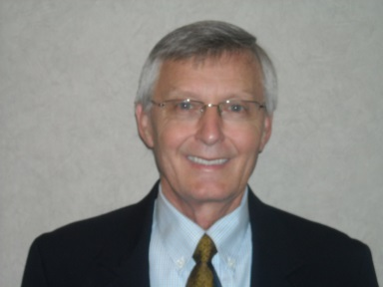
Famous CGFMs

Slide 16
Famous CGFMs
Jan I Sylvis, CGFM, CPA
GASB Board Member
Chief of Accounts,
Tennessee Department of Finance and Administration

Slide 17
Just Who or What is a CGFM?
To Whom It May Concern:
Pursuant to your instructions, I have enclosed my application for the Certified Government Financial Manager Program. I was grandfathered into the program and have my CGFM certificate. However, I have decided to relinquish my certificate and to take the examination to be certified. Because of this, you advised that I do not have to include proof of my University Degree or verification of my work experience which was previously provided. Please process my application as quickly as possible inasmuch as I will be attempting to take the examination in the near future after finishing the CGFM courses in March 2000. I have enclosed my personal check for the $75.00 application fee. Thank you for your prompt attention to this matter.
Respectfully,
____________________
Jerry E. Durham

Slide 18
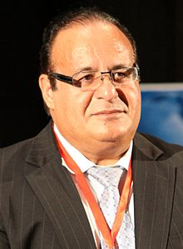
Just Who or What is a CGFM?
Zabihollah Rezaee (PhD, CPA, CFE, CMA, CIA, CGFM, CSOXP, CGOVP, CGRCP, CGMA, CRMA) is the Thompson-Hill Chair of Excellence and Professor of accounting at the University of Memphis. Based his valuable contribution in academic and professional activities, many believe that he is the most famous Iranian accountant in the world. Currently, he is the secretary of FIA (the Forensic & Investigative Accounting Section of the American Accounting Association, AAA). Also, he has served (two years) on the SAG (Standing Advisory Group of the Public Company Accounting Oversight Board, PCAOB).

Slide 19
Just Who or What is a CGFM?
He has these professional certifications:
CPA (Certified Public Accountant, AICPA);
CFE (Certified Fraud Examiner, ACFE);
CMA (Certified Management Accountant, ima);
CIA (Certified Internal Auditor, IIA);
CGFM (Certified Government Financial Manager, AGA);
CSOXP (Certified Sarbanes-Oxley Professional, The GRC Group);
CGOVP (Certified Corporate Governance Professional, The GRC Group);
CGRCP (Certified Governance Risk Compliance Professional, The GRC Group);
CGMA (Chartered Global Management Accountant, AICPA & CIMA); and
CRMA (Certified Risk Management Assurance, IIA).

Slide 20
Introduction to the CGFM Program
AGA’S Office of professional certification

Slide 21
CGFM: initial requirements
Ethics – read and agree to abide by AGA’s Code of Ethics
Education – have a bachelor’s degree from an accredited college or university
Examinations – pass three comprehensive CGFM Examinations
Experience – have at least two years of professional-level experience in government financial management
More information – www.agacgfm.org/cgfm

Slide 22
Certification process
Step 1—Read AGA's Code of Ethics
Step 2—Apply for the CGFM Program
Step 3—Submit Required Degree Documentation
Step 4—Receive an Eligibility Letter
Step 5—Submit a Work Verification Form
Step 6—Prepare for the CGFM Examinations
Step 7—Schedule the CGFM Examinations
Step 8—Take and Pass the CGFM Examinations
Step 9—Receive CGFM Award Letter
Step 10—Receive and Display Your CGFM Certificate
More information – www.agacgfm.org/cgfm/process

Slide 23
CGFM: costs
Earning the certification
Application fee – $85
Examination fees – $109 per exam
Maintaining the certification
Annual renewal fee – $30 for AGA members or $65 for nonmembers
Study Guides (3)
Printed only - $85
Print and online version - $139
Questions? Email AGA’s Office of Professional Certification at agacgfm@agacgfm.org

Slide 24
CGFM: costs
Application Fee =
Three Study Guides =
Three Exams =
Total Cost =
$ 85
$ 417
$ 327
_____
$ 829

Slide 25
Preparing for examinations
Three Exams:
Governmental Environment.
Governmental Accounting, Financial Reporting and Budgeting.
Governmental Financial Management and Control

Slide 26
Preparing for examinations
The big lies!
Passing the exams will be easy.
I can’t pass the exams.
The exams are for accountants.

Slide 27
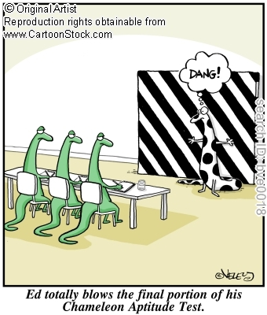

Slide 28
Preparing for examinations
Start with exam content outlines
www.agacgfm.org/cgfm/exams
Preparation options
Courses – GFM and Intensive Review
Self-study – study guides and study references
Other options – My suggestions.
More information – www.agacgfm.org/cgfm/prepare

Slide 29
Example of Exam Question
Government Environment Exam
According to the AGA Code of Ethics, a vendor using an agency contract monitor as a personal reference on a resume, would constitute
A. Fraud
B. Professional incompetence
C. A Conflict of interest
D. Nepotism

Slide 30
CGFM: requirements to maintain
Ethics – continue to abide by AGA’s Code of Ethics
Renewal – renew the designation annually
Continuing education – complete 80 hours of applicable continuing professional education (CPE) every two years
More information – www.agacgfm.org/cgfm/maintain

Slide 31
Enhance your marketability
CGFM is the mark of professional excellence
CGFM is transferrable across agencies and government levels
Refer to Ron Queen’s “Why become a CGFM” on your tables.
Apply today at www.agacgfm.org/cgfm/apply

Slide 32
For more information
To obtain more information, contact:
Jerry E. Durham, CGFM
Jerry.Durham@cot.tn.gov
615.401.7951

Slide 33
For more information
To obtain more information, contact:
Brian Watkins
Certification Manager at
bwatkins@agacgfm.org
or
Katya Silver
Director of Professional Certification at
ksilver@agacgfm.org

Slide 34
Questions
Jerry E. Durham
Jerry.Durham@cot.tn.gov
615.401.7951
The Opinions expressed during this presentation were my own. They do not necessarily represent the views of the Comptroller, his representatives, or the Department of Audit.

