Slide 1
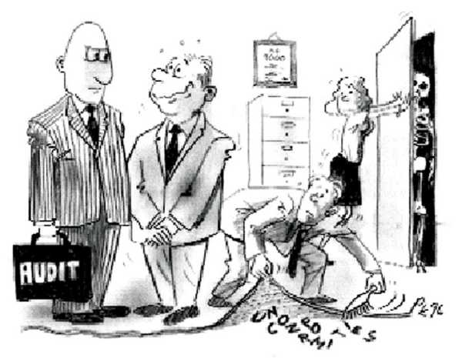
AUDITOR / AUDITEE RELATIONS – THE GOOD, THE BAD, AND THE UGLY
Jim Arnette, CGFM, CISA
AGA National President April rch 16, 2018
www.agacgfm.org

Slide 2
AUDITOR / AUDITEE RELATIONS – THE GOOD, THE BAD, AND THE UGLY

Slide 3
AUDITOR / AUDITEE RELATIONS – THE GOOD, THE BAD, AND THE UGLY

Slide 4
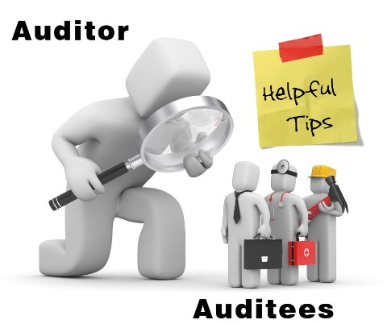
AUDITOR / AUDITEE RELATIONS – THE GOOD
COOPERATION
PROFESSIONALISM
COMMUNICATION

Slide 5
AUDITOR / AUDITEE RELATIONS – THE GOOD
COOPERATION
PROFESSIONALISM
COMMUNICATION
INDEPENDENCE
RESPECT

Slide 6
AUDITOR / AUDITEE RELATIONS
AUDITOR
AUDITEE

Slide 7
AUDITOR / AUDITEE RELATIONS – THE BAD
COOPERATION
INTIMIDATION
PROFESSIONALISM
COMMUNICATION
FEAR
INDEPENDENCE
RESPECT

Slide 8
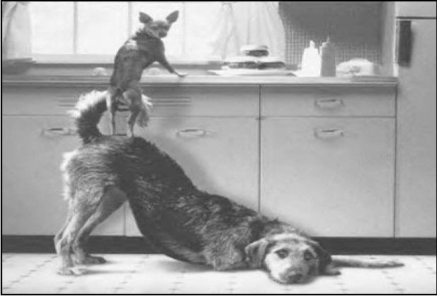
AUDITOR / AUDITEE RELATIONS – THE GOOD, THE BAD, AND THE UGLY
COOPERATION
COMMUNICATION
TRUST

Slide 9
AUDITOR / AUDITEE RELATIONS – THE GOOD, THE BAD, AND THE UGLY
Auditee hires an independent auditor
Auditor is paid by the auditee to assess the auditee’s financial operations
Auditor issues a report – Could be critical of the auditee

Slide 10
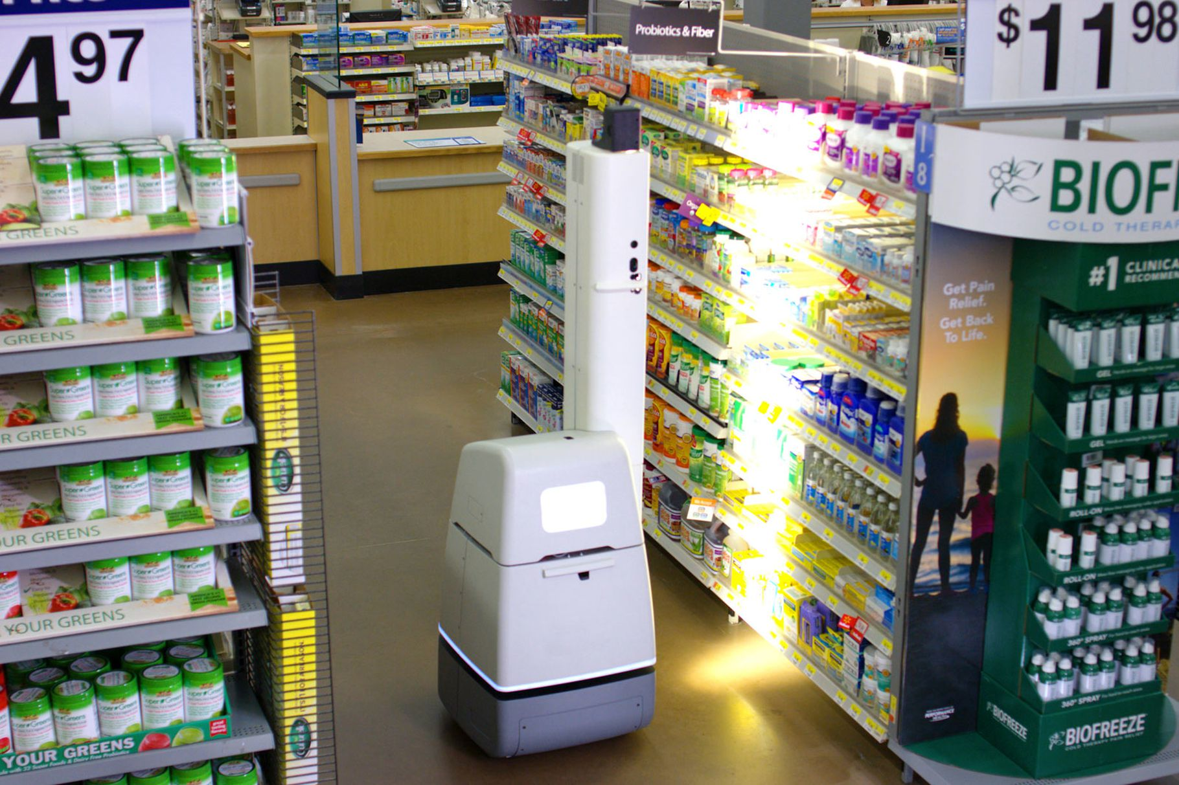
AUDITOR / AUDITEE RELATIONS

Slide 11
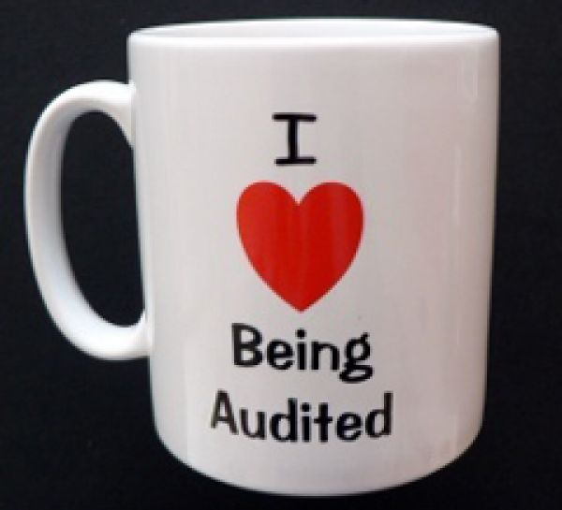
AUDITOR / AUDITEE RELATIONS – THE GOOD, THE BAD, AND THE UGLY
HOW TO SURVIVE YOUR AUDIT
Be respectful of the auditors time
Don’t be intimidated
Communicate
Honesty is important
Be cooperative
Be responsive
FIND YOUR AUDITORS A GOOD PLACE TO WORK!

Slide 12
AUDITOR / AUDITEE RELATIONS – THE GOOD, THE BAD, AND THE UGLY
AUDITEES COME IN ALL SHAPES AND SIZES
Compliant Types
Submissive Types
Professionals
Indifferent Types
I-Know-Everything-Better Types
Unwilling Types

Slide 13
AUDITOR / AUDITEE RELATIONS
My friends, arguing with an auditor is like wrestling a pig in the mud
Sooner or later you’re going to realize, the pig likes the mud

Slide 14
AUDITOR / AUDITEE RELATIONS – THE GOOD, THE BAD, AND THE UGLY
HOW TO SURVIVE YOUR AUDIT
Ask questions
Be open to constructive criticism
Keep your cool
Stand your ground

Slide 15
AUDITOR / AUDITEE RELATIONS – THE GOOD, THE BAD, AND THE UGLY
HOW TO GET ALONG WITH THE AUDITEE
Communicate

Slide 16
AUDITOR / AUDITEE RELATIONS – THE GOOD, THE BAD, AND THE UGLY
HOW TO GET ALONG WITH THE AUDITEE
Communicate
Be respectful of the auditee

Slide 17
AUDITOR / AUDITEE RELATIONS – THE GOOD, THE BAD, AND THE UGLY
HOW TO GET ALONG WITH THE AUDITEE
Communicate
Be respectful of the auditee
Don’t be intimidated
Create an atmosphere of acceptance and understanding
Ask good questions
Listen

Slide 18
AUDITOR / AUDITEE RELATIONS – THE GOOD, THE BAD, AND THE UGLY
You aren’t learning anything when you’re talking…
Lyndon B. Johnson

Slide 19
AUDITOR / AUDITEE RELATIONS – THE GOOD, THE BAD, AND THE UGLY
ACTIVE LISTENING – TAKE 1
Auditee: I just don’t understand why this audit has to be done right now…Don’t you know this is a really busy time for us? Don’t you know we’re trying to close out the month and my bookkeeper’s in Vegas?
Auditor: Yeah…But my supervisor says we’ve got to get this audit done…You’re just going to have to deal with it…
Auditee: Don’t you know we’re stretched really thin, especially with all the extra work we’ve had to do to comply with the new GASB standards?
Auditor: Hey…I don’t make the standards…They just tell us what we’ve got to do…And, I don’t decide when the audit has to be done…My job’s to make sure the audit gets done and that’s what I’m going to do…You want my boss’s number?
Auditee: My staff’s not going to like this…
Auditor: Whatever…That’s your problem, not mine…

Slide 20
AUDITOR / AUDITEE RELATIONS – THE GOOD, THE BAD, AND THE UGLY
ACTIVE LISTENING – TAKE 2
Auditee: I just don’t understand why this audit has to be done right now…Don’t you know this is a really busy time for us? We’re trying to close out the month and my bookkeeper’s on vacation…
Auditor: I know…It sounds like the audit’s going to create some problems for you…
Auditee: It sure is…We’re stretched really thin, especially with all the extra work we’ve had to do to comply with the new GASB standards…Are they ever going to let up?
Auditor: Yeah, these new standards have been tough on both of us…
Auditee: My folks are under a lot of stress…Everything we do is rush, rush, rush…
Auditor: I can relate…Our folks have been working extremely hard to meet our audit deadline…
Auditee: Hey, I know you’re just doing your job…Thanks for listening…We’ll make this work…You’re a lot nicer than our last auditor…

Slide 21
AUDITOR / AUDITEE RELATIONS – THE GOOD, THE BAD, AND THE UGLY
AUDITORS ARE THE BOMB DIGGITY
Theoretical Ones
Freewheelers
Pushers
Professionals
Fickle Ones

Slide 22
AUDITOR / AUDITEE RELATIONS – THE GOOD, THE BAD, AND THE UGLY

Slide 23
AUDITOR / AUDITEE RELATIONS – THE GOOD, THE BAD, AND THE UGLY
BE PROFESSIONAL
Don’t be argumentative

Slide 24
AUDITOR / AUDITEE RELATIONS – THE GOOD, THE BAD, AND THE UGLY
You really can’t “win” an argument…If you lose it, you’ve lost it…If you win the argument, you still lose because that unpleasant exchange is probably going to cost you some good will down the road…
Dale Carnegie

Slide 25
AUDITOR / AUDITEE RELATIONS – THE GOOD, THE BAD, AND THE UGLY
BE PROFESSIONAL
Don’t be argumentative
Don’t seek confrontation
Don’t have a gotcha attitude

Slide 26
AUDITOR / AUDITEE RELATIONS – THE GOOD, THE BAD, AND THE UGLY
BE PROFESSIONAL
Don’t be argumentative
Don’t seek confrontation
Don’t have a gotcha attitude
Don’t use the phrase, “Write you up...”
Don’t use unnecessary technical jargon
Don’t make it us versus them
Don’t try to humiliate each other

Slide 27
AUDITOR / AUDITEE RELATIONS – THE GOOD, THE BAD, AND THE UGLY
BE PROFESSIONAL
Don’t be argumentative
Don’t seek confrontation
Don’t have a gotcha attitude
Don’t use the phrase, “Write you up...”
Don’t use unnecessary technical jargon
Don’t make it us versus them
Don’t try to humiliate each other
Don’t make unwarranted assumptions

Slide 28
AUDITOR / AUDITEE RELATIONS – THE GOOD, THE BAD, AND THE UGLY
BE PROFESSIONAL
Don’t be argumentative
Don’t seek confrontation
Don’t have a gotcha attitude
Don’t use the phrase, “Write you up...”
Don’t use unnecessary technical jargon
Don’t make it us versus them
Don’t try to humiliate each other
Don’t make unwarranted assumptions
No surprises

Slide 29
AUDITOR / AUDITEE RELATIONS – THE GOOD, THE BAD, AND THE UGLY
INDEPENDENCE
No close relationships
Don’t accept any gifts or undue hospitality

Slide 30
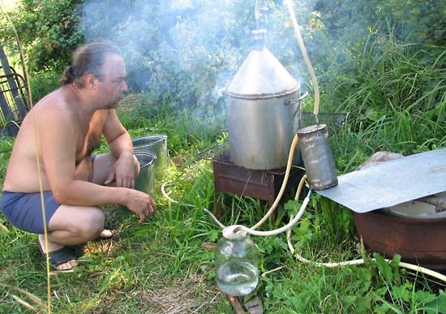
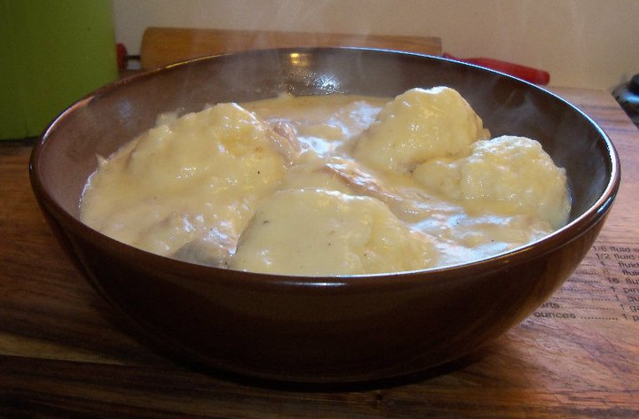
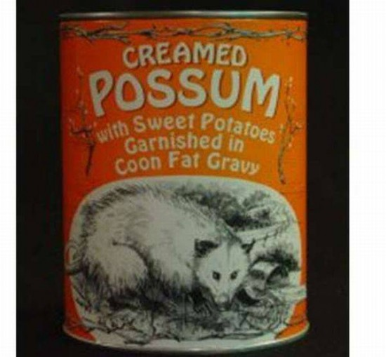
AUDITOR / AUDITEE RELATIONS – THE GOOD, THE BAD, AND THE UGLY

Slide 31
AUDITOR / AUDITEE RELATIONS – THE GOOD, THE BAD, AND THE UGLY
INDEPENDENCE
No close relationships
Don’t accept any gifts or undue hospitality
Be aware of strong personalities

Slide 32
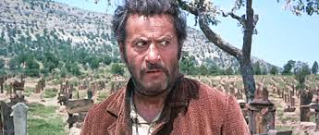
AUDITOR / AUDITEE RELATIONS – THE UGLY

Slide 33
AUDITOR / AUDITEE RELATIONS – THE GOOD, THE BAD, AND THE UGLY
INDEPENDENCE
No close relationships
Don’t accept any gifts or undue hospitality
Be aware of strong personalities
Auditor rotation is a good thing

Slide 34
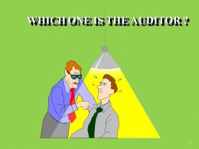
AUDITOR / AUDITEE RELATIONS – THE GOOD, THE BAD, AND THE UGLY
INTIMIDATION
FEAR

Slide 35
AUDITOR / AUDITEE RELATIONS – THE GOOD, THE BAD, AND THE UGLY

Slide 36
AUDITOR / AUDITEE RELATIONS
INTIMIDATION
FEAR

Slide 37
AUDITOR / AUDITEE RELATIONS – THE GOOD, THE BAD, AND THE UGLY
CHUCKEY UTILITY DISTRICT

Slide 38
AUDITOR / AUDITEE RELATIONS – THE GOOD, THE BAD, AND THE UGLY
COOPERATION
PROFESSIONALISM

Slide 39
AUDITOR / AUDITEE RELATIONS – THE GOOD, THE BAD, AND THE UGLY
If you’re right and you’re rude, you’re wrong...

Slide 40
AUDITOR / AUDITEE RELATIONS – THE GOOD, THE BAD, AND THE UGLY
COOPERATION
PROFESSIONALISM
COMMUNICATION
INDEPENDENCE
RESPECT
= TRUST

Slide 41
AUDITOR / AUDITEE RELATIONS – THE GOOD, THE BAD, AND THE UGLY
“Accountants and accountability professionals working together to make government work better…”
Jim Arnette
AGA National President
Jim.Arnette@cot.tn.gov
615.401.7841

